Slide 1

Web scraping to gain company insights
13/03/2024 – Amrit singh

Slide 2
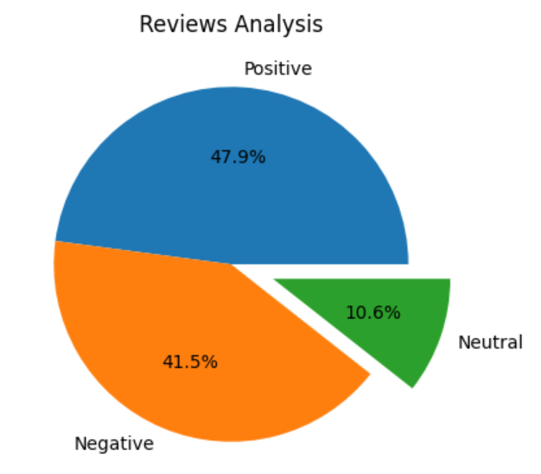
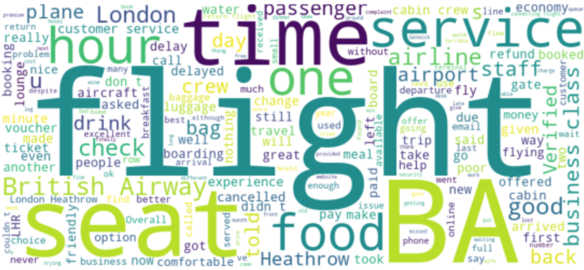
INSIGHTS FROM CUSTOMER REVIEWS :
From cleaning 1000 reviews given by the customers, we obtained :
Positive Reviews - 479
Negative Reviews - 415
Neutral Reviews – 106
Word cloud of keywords used in reviews :

